Slide 1

OCEAN RESCUE
“THE NANNIES”
Katiera Boone
Jae’da Williams
Haya Al-ghazouli
Sara Alashqar

Slide 2
What is TAP?
TAP Project Goals:
We want to increase the number of students who persist and pursue an IT major or minor
We also want to develop leadership skills, communication, and technical skills
Provide student-lead, student driven tech support for GGC outreach initiatives and for intro STEM courses
Tap stands for the Technology Ambassador program
STEC 4800 : Internship in Service-Learning
Develop educational technology directed towards non-IT students and students K-12
Notes:
Register for TAP
Capitalize tap

Slide 3
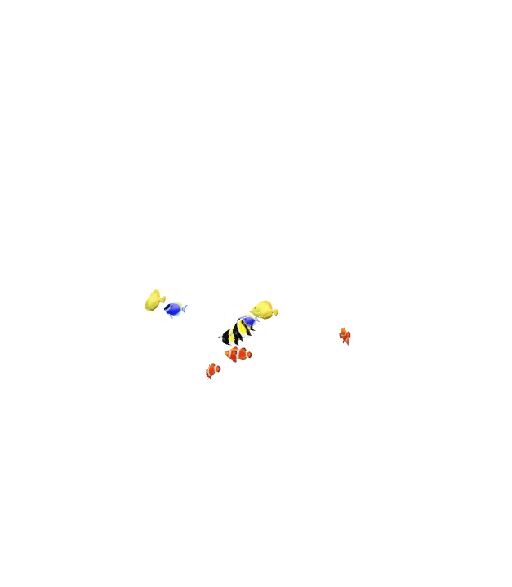

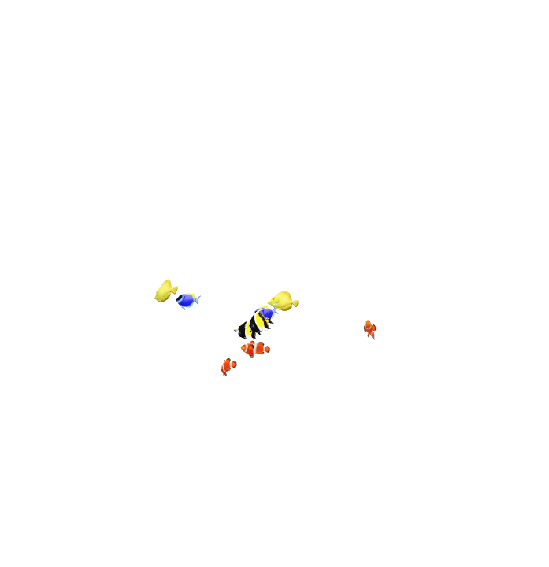
If you simply throw the net out there, you don’t know what you might catch! :
Who is this study geared towards?
This study is gear towards minorities and women/girls
“Women make up only 28% of the workforce in science, technology, engineering and math (STEM), and men vastly outnumber women majoring in most STEM fields in college.”
Why are you doing this study?
By Engaging the youth to develop interest in technology at an early age, we can light a spark for them in the future.
Our game allows us to provide a way of doing outreach to our audience through active learning in a very fun and hands on way.
"Never doubt that a small group of thoughtful, committed citizens can change the world; indeed, it's the only thing that ever has." ~ Margaret Mead
Notes:
https://www.aauw.org/resources/research/the-stem-gap/#:~:text=Women%20make%20up%20only%2028%25%20of%20the%20workforce,like%20computer%20science%20and%20engineering.%20Why%20So%20Few%3F
https://www.azquotes.com/quotes/topics/outreach.html
We are committed and motivated to pouring all that we can into the generations coming behind us.

Slide 4
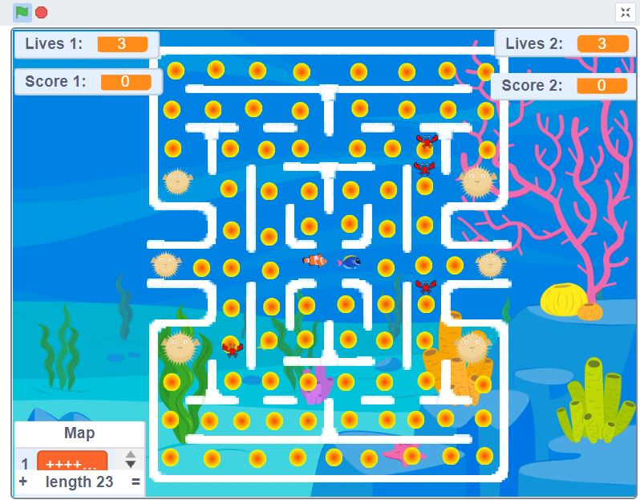

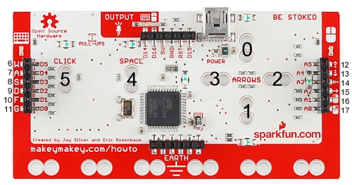
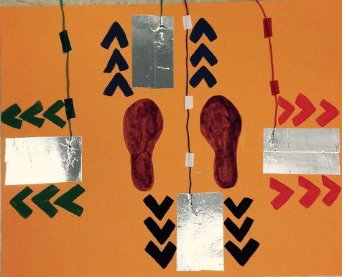
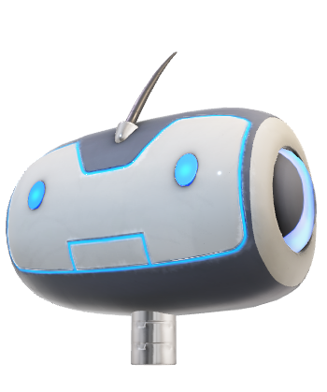
PROJECT DETAILS & METHODS
What are we doing?
Our Group created a game reminiscent of the cult classic game PACMAN, and we named it Ocean Rescue
Technology used:
The technology we will be using is a fusion of Scratch and Makey Makey
How we are going to use the technology to achieve our goals:
We will use this technology to teach our audience how to code using basics fundamental coding principles by allowing them to recreate their own unique version of our game with these same ideologies
What are we trying to teach:
We are trying to teach how to implement:
If, Then statements in blocks of code
Iteration with a score counter; and
Manipulating Variables

Slide 5
Here is a link to our game OCEAN RESCUE
https://scratch.mit.edu/projects/575312420

Slide 6
Let’s Get Started
1. Open Scratch and create an account:
https://scratch.mit.edu/
2. Here we will Start to create our Game!!! (Click See inside and hit the green flag)
https://scratch.mit.edu/projects/582468441

Slide 7
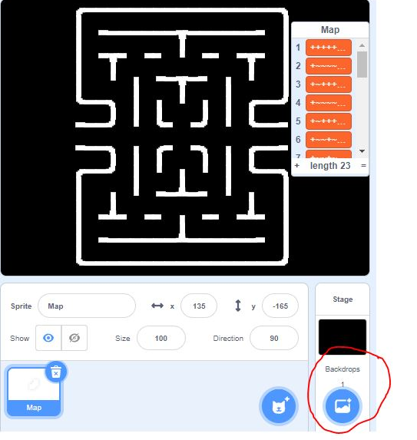

Creating the Board Back drop
This is what your Beginner Board will look like
CHOOSE A BACKDROP WITH LITTLE TO NO WHITE

Slide 8
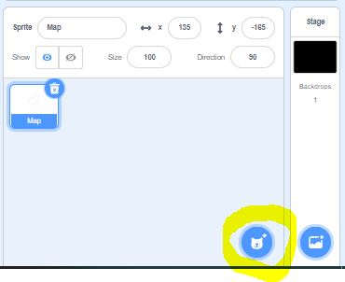
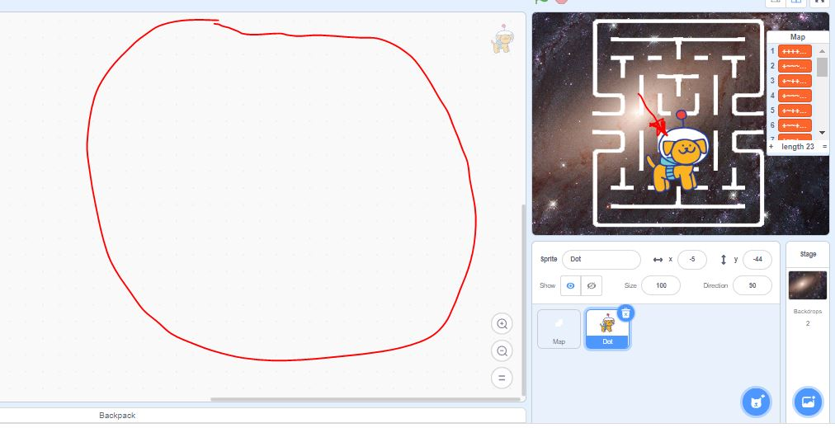
CREATING THE MAIN CHARACTER
CREATE A MAIN SPRITE CHARACTER
HERE WE WILL BE WRITING CODE FOR OUR MAIN SPRITE

Slide 9
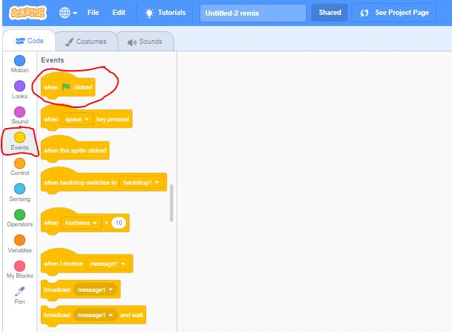
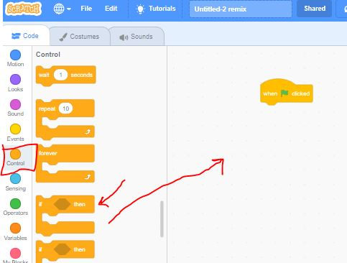
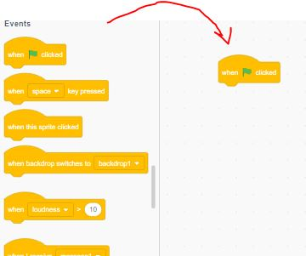
GETTING OUR MAIN SPRITE TO MOVE
WE WILL ADD IF THEN STATEMENTS TO MANIPULATE OUR CHARACTERS MOVEMENT
DRAG AND DROP WHEN FLAG CLICKED INTO YOUR WORK SPACE

Slide 10
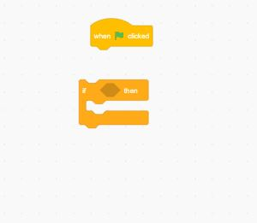
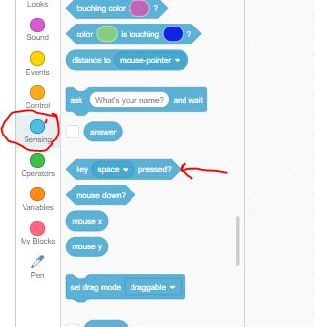
GETTING OUR MAIN SPRITE TO MOVE
DRAG AND DROP YOR IF THEN STATEMENT ONTO THE WORLSPACE
DRAG KEY PRESSED ON TO YOUR WORKSPACE

Slide 11
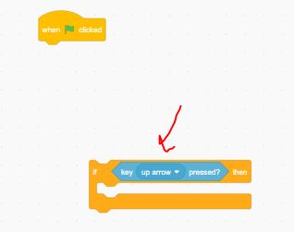
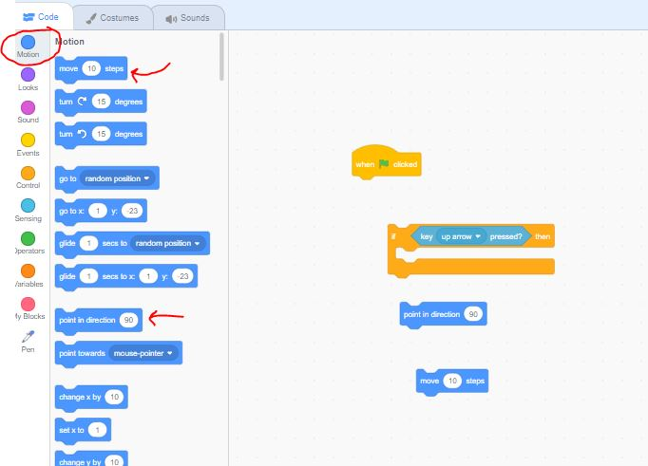
GETTING OUR MAIN SPRITE TO MOVE
ADD TO YOUR IF THEN STATEMENT
(INSIDE OF THE SHAPE)
DRAGE AND DROP POINT IN DIRECTION
AND MOVE 10 STEPS TP WORKSPACE

Slide 12
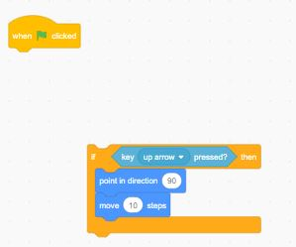
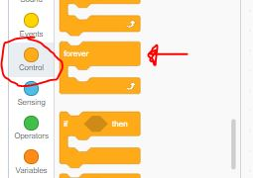
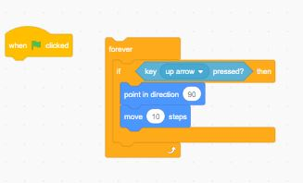
GETTING OUR MAIN SPRITE TO MOVE
PLACE IF THEN INSIDE YOUR FOREVER LOOP AND PLACE UNDER YOUR GREEN FLAG
ADD BOTH TO THE IF THEN STATEMENT
GRAB A FOREVER LOOP

Slide 13
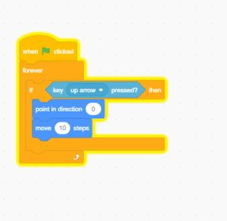
THIS IS HOW YOUR STATEMENT SHOULD LOOK…PRESS THE GREEN FLAG A WATCH IT MOVE!

Slide 14
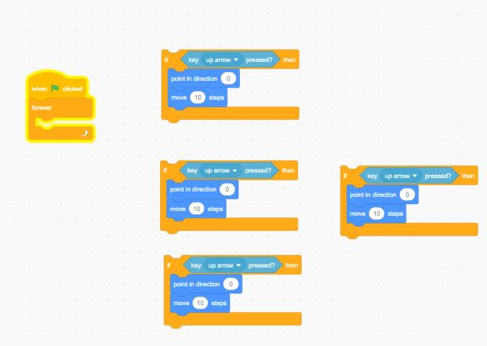

NOW LETS DO IT FOR ALL 4 DIRECTIONS (UP, DOWN, LEFT, RIGHT
RIGTH CLICK AND DUPLICATE 3 MORE TIMES
PULL OUT YOUR IF STATEMENT FROM FOREVER LOOP

Slide 15
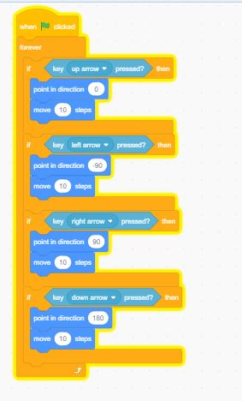
UP, DOWN, LEFT, RIGHT
CHANGE: KEY PRESSED AND POINT IN DIRECTION KEYS FOR ALL 4 IF STATEMENTS AND ADD TO YOUR FOREVER LOOP

Slide 16
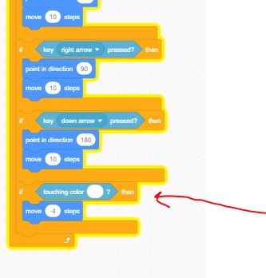
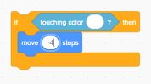
LOCKING MAIN SPRITE ONTO BOARD
GRAB NEW IF, THEN BLOCK →GO TO SENSING→ GRAB TOUCHING COLOR →ADD TO THE IF, THEN BLOCK
ADD TO YOUR FOREVER LOOP

Slide 17
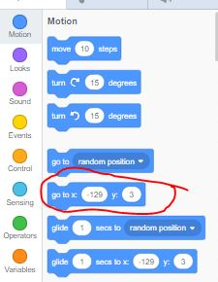
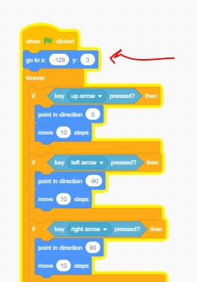
GIVE A START POINT FOR YOUR MAIN SPRITE

Slide 18
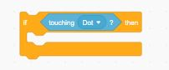
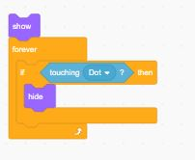

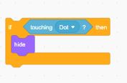
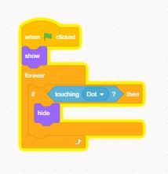
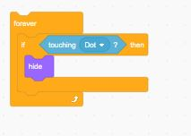
CREATING THINGS TO BE COLLECTED
WHEN FLAG PRESSED
CREATE A NEW SPRITE AND PICK SOMETHING YOUR CHARACTER CAN COLLECT

Slide 19
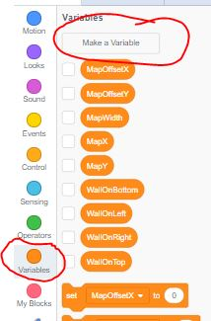
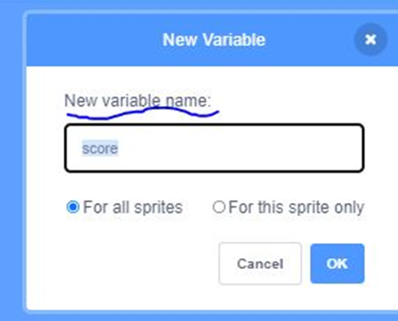
CREATING A SCORE COUNTER

Slide 20
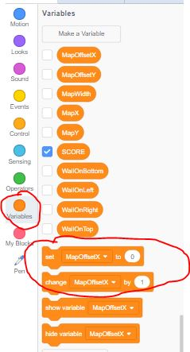
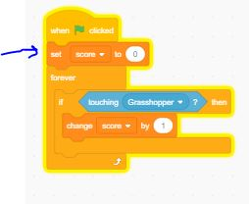
MANIPULATING THE SCORE
GRAB SET TO 0 && CHANGE BY 1 → ADD BOTH TO YOUR WORKSPACE → THEN ADD BOTH TO YOUR IF STATEMENT

Slide 21
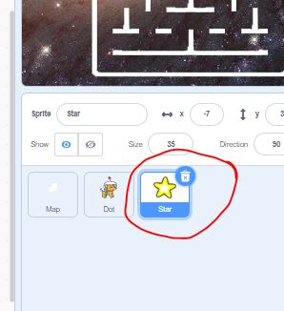
THINGS TO BE COLLECTED
RIGHT CLICK ON THE COLLECTED SPRITE AND HIT DUPLICATE.
MAKE AS MANY OF THESE SPRITES AS YOU WOULD LIKE AND ADD THEM ALL OVER YOUR BOARD

Slide 22
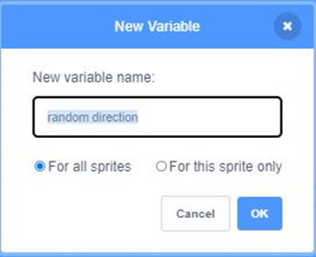
THE ENEMY
CHOOSE AN ENEMY BY MAKING A NEW SPRITE
Create a random DIRECTION variable

Slide 23
GETTING THE ENEMY TO MOVE
GRAB THE IF THEN STATEMENT BLOCK
OUR DIRECTIONS WILL BE NORTH, SOUTH, EAST AND WEST (WE WILL GIVE THESE THE VALUES 1, 2, 3, 4)
N = 1
S = 2
E = 3
W = 4

Slide 24
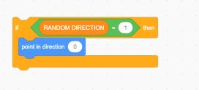
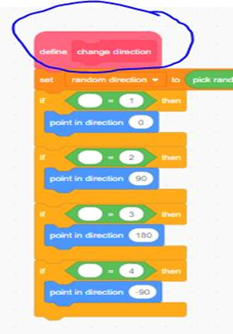
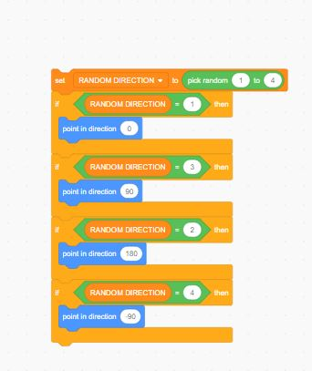
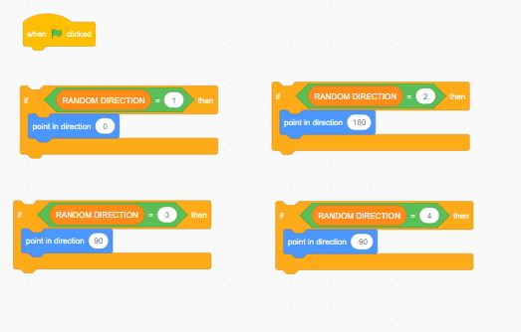
RANDOM MOVEMENT - ENEMY
4
3
1
2

Slide 25
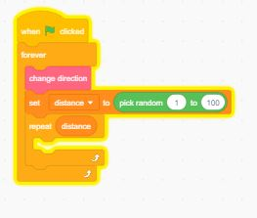
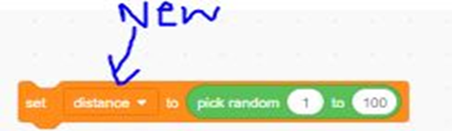
GIVE THE ENEMY A DISTANCE TO MOVE
CREATE A NEW VARIABLE NAMED DISTANCE
THIS IS HOW YOUR BLOCK SHOULD LOOK
SET YOUR DISTANCE
ADD MOVE 10 STEPS BLOCK BELOW SET DISTANCE

Slide 26
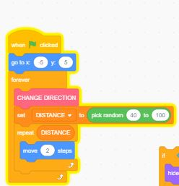
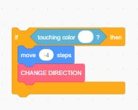
MOVING RANDOM CONT’D
ADD MOVE 2 STEPS JUST BELOW THE REPEAT DISTANCE
LOCK ENEMY TO BOARD
ADD THIS IF STATENMENT TO THE LOOP, BELOW MOVE 2 STEPS

Slide 27
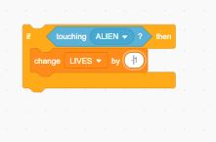
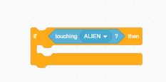
ELIMATE MAIN CHARACTER LIVES IF TOUCHING THE ENEMY
ADD THE CHANGE BY TO YOUR LOOP AND CHANGE LIVES BY -1
GO TO THE MAIN CHARACTER AND GRAB AN IF THEN STATEMENT
ADD AN IF TOUCHING ENEMY
NOW CREATE A NEW VARIABLE CALLED LIVES

Slide 28
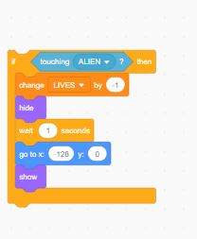
MAIN CHARCTER DISAPPEAR AFTER BEING CAPTURED
ADD HIDE → WAIT →GO TO → AND A SHOW BUTTON
THEN ADD TO YOUR LOOP

Slide 29
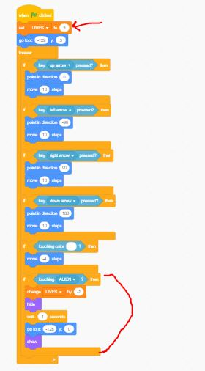
AT THE TOP OF YOUR LOOP SET LIVES TO 3
YOU CODE SHOULD NOW LOOK LIKE THIS:

Slide 30
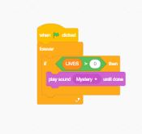
ADD SOUND

Slide 31

STOP GAME

Slide 32
Please fill out the survey and give us as much feedback as you would like!!!

Slide 33

Questions? Comments? Concerns?
Thanks for joining!!
We hope you enjoyed our Game Workshop!

Slide 34

Welp time to MOOOve along then!!!

